Slide 1
Canada and USA Energy Production vs. $$$ Strength
Project 1
Team: Kelvin Deng, Thao Hoang, May Ang, Yijing Su
Date: Nov 12, 2020

Slide 2
Agenda
Topic motivation
Work process (data exploration, transformation, and analysis)
Findings and implications
Next steps

Slide 3

Motivation
Energy and the Economics
Oil Exports and Dollar Strengths
Future of Renewable Energy and Dollar Strengths

Slide 4

Motivation Background
Crude oil is the largest single contributor of Canada’s revenue from foreign exchanges.
The contribution of oil export volume to the economics (e.g. GDP).
CA production exported to US 2018:
Crude oil: 84% (48% of total US imports)
Notes:
CA: ranked 4th in Crude Oil production and export
US:
https://www.investopedia.com/articles/investing/021315/how-why-oil-impacts-canadian-dollar-cad.asp
Source; Energy Fact Book 2019-2020

Slide 5
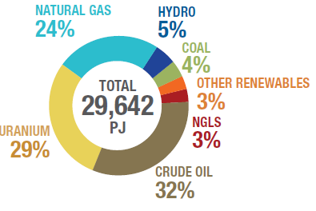
Motivation Background
CA primary energy production 2017:
Crude oil 32%
Hydro and Other renewable: 8%
Despite the large oil reserve in Canada, the world is shifting towards using clean and renewable energy in the near future.
How would lower crude oil demand affect Canadian economics and CAD?

Slide 6

Questions of Interest
1/ Historical correlations between:
Crude Exports vs. Dollar
Crude GDP Contribution vs. Dollar
2/ Forecast of dollar strength in the evolving energy industry?
Renewable Energy Production and Projection into Future
Renewable Energy Production vs. Dollar

Slide 7
Data Exploration
Data 1 Crude Export
EIA – US Energy Information Administration
STATCAN – Statistics Canada
Crude Export vs. Dollar
Crude GDP Contribution vs. Dollar
Data 2 Dollar Strength
Trading Economics.com
Exchange Rate API (open source)
Data 3 Renewable Energy
Energy Production from Renewable Sources
Renewable Energy vs. Dollar
BEA – Bureau of Economic Analysis
CER – Canadian Energy Regulator

Slide 8
Data Transformation Challenges
Limited data on energy production
Bad quality data (NaN rows, random spaces, duplicated titles)
Incomplete data sets with empty rows
Structural conflicts (rows vs. columns)
Something new we learned during the process:
Datetime Library

Slide 9
Data Analysis Process
1. Brainstorm expected results (Planning)
2. Raw data cleaning (Extraction)
3. Merge and analyze (Transformation)
4. Plotting and draw conclusions
(Plotting)
Python on Jupyter Notebook
& GitHub Branches

Slide 10
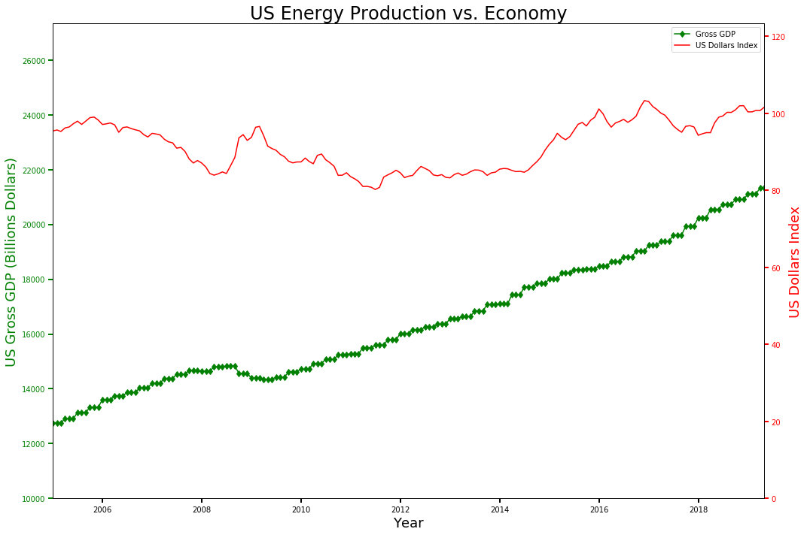
Findings – US and its Oil
Over the past 15 years:
Linear growth of US GDP (1.5x) while US Dollars Index follows a cyclical trend and increases by (1.05x)
 | Crude Prod. | US GDP
US GDP |  | -
USD Index |  | 0.37
Recession

Slide 11
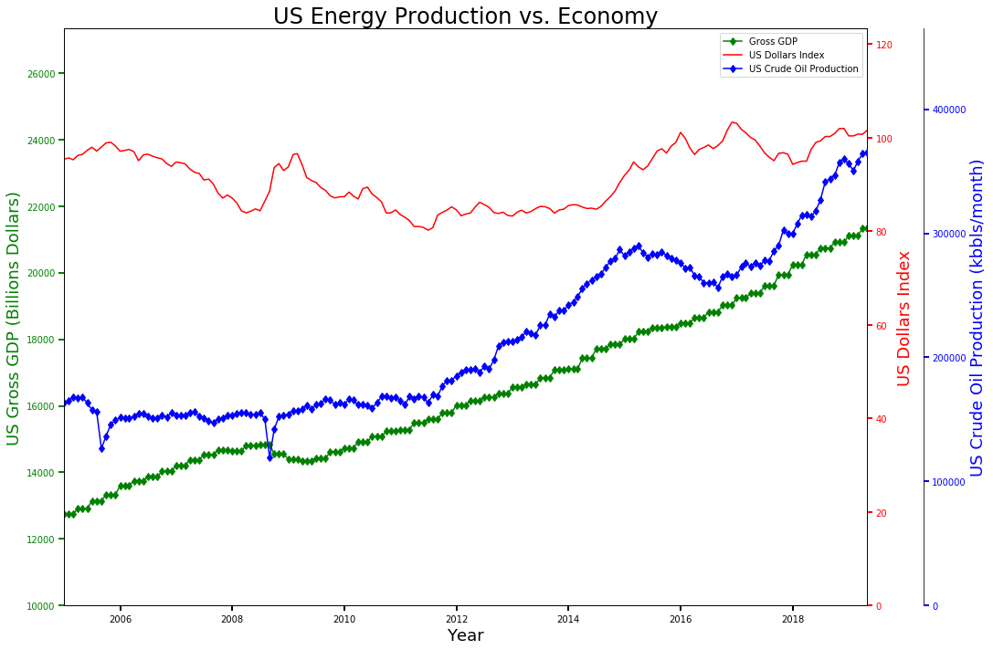
Findings – US and its Oil
Over the past 15 years:
Linear growth of US GDP while US Dollars Index follows a cyclical trend
curtailment
Linear growth of US Crude Production with some curtailments in 2015-2016
 | Crude Prod. | US GDP
US GDP | 0.96 | -
USD Index | 0.44 | 0.37

Slide 12
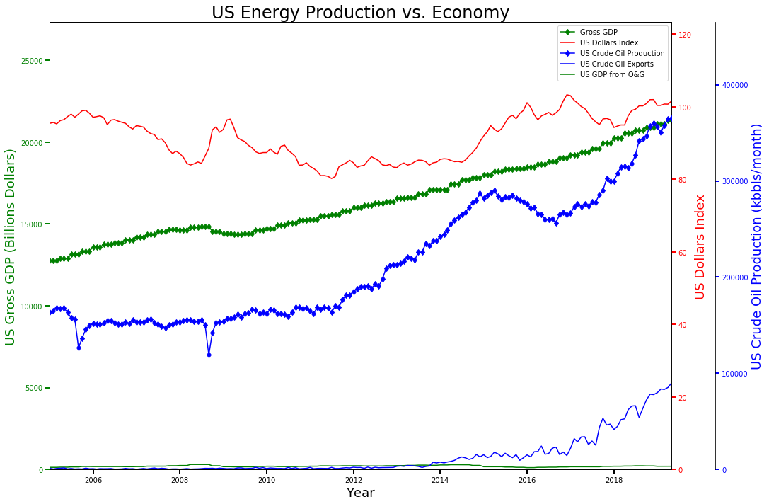
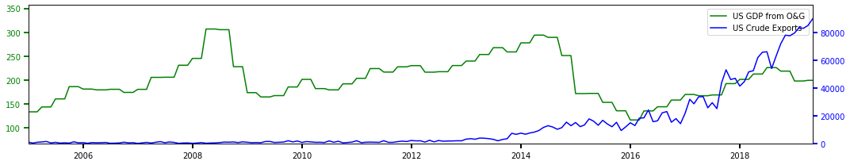
Findings – US and its Oil
US Crude Exports increases from ~0% before 2012 to ~25% in 2019
But GDP contribution from O&G only accounts for ~1% of Gross GDP
→ No expected correlation with neither GDP nor US Dollar Index
 | Crude Export | GDP from O&G
USD Index | 0.55 | -0.64

Slide 13
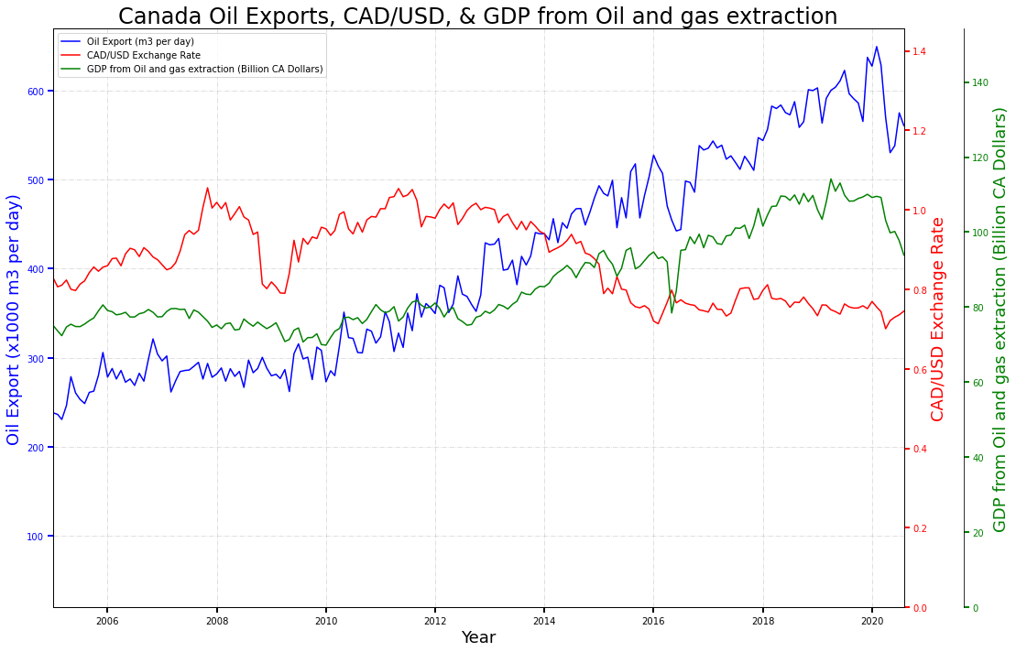
Findings – Canada and its Oil
Plot shows:
Oil Exports
GDP Contribution of Oil
CAD/USD Exchange Rate
- CAD/USD rate decreases (CAD strengthens as production ↑ )
- Interesting relationship between GDP contribution and Oil exports

Slide 14
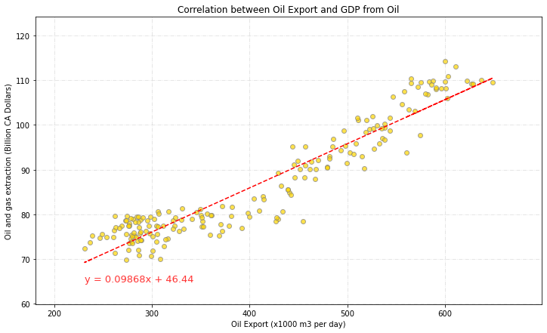
Findings – Canada and its Oil
GDP is the measure of a country’s productivity
More productivity, higher contribution
More productivity in Oil industry, higher exports
Conclude that most of the oil extracted is for other countries

Slide 15
Findings – US Electricity Production by Source
Renewable Sources
Oil Sources (Not Clean)
Wood
Waste
Geothermal
Solar
Wind
Conventional Hydroelectric Power
Coal
Petroleum
Natural Gases
Other Gases

Slide 16
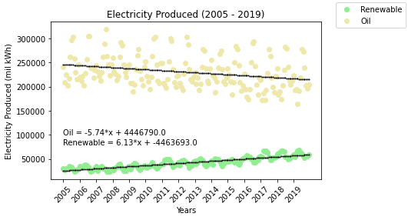
Findings – US Electricity Production by Source
Slope is in mil kWh/month
Point of intersect : Nov 2055
Production from renewable sources increases as the other decreases

Slide 17
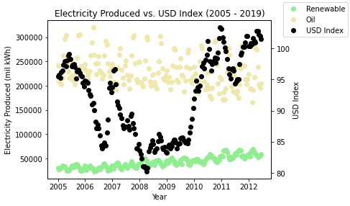
Findings – US Electricity Production by Source
No obvious correlation between energy production and US index

Slide 18
Findings – Canada Electricity Production by Sources
Su’s plots

Slide 19
Findings – Canada Electricity Production by Sources

Slide 20
Limitations of Analysis
Disregarded other factors affecting the economics
First date of the month was representative of the entire month

Slide 21
Next steps
Investigation into any new renewable energy initiatives (timing, production impact etc.)
Gain an understanding of other factors affecting economics
Energy production is not limited to electricity
Should explore other uses of energy (e.g. Heating)

Slide 22
References
[1] | Statistics Canada, "Electric power generation, monthly generation by type of electricity," 9 11 2020. [Online]. Available: https://www150.statcan.gc.ca/t1/tbl1/en/tv.action?pid=2510001501. [Accessed 11 11 2020].
[2] | Statistics Canada, "Gross Domestic Product by Industry - National (Monthly) (GDP)," 30 10 2020. [Online]. Available: https://www150.statcan.gc.ca/t1/tbl1/en/tv.action?pid=3610043402. [Accessed 11 11 2020].
[3] | US Energy Information Administration, "Total Energy : Monthly Energy Review," 27 10 2020. [Online]. Available: https://www.eia.gov/totalenergy/data/monthly/index.php#electricity. [Accessed 11 11 2020].
[4] | MacroTrends, "U.S. Dollar Index - 43 Year Historical Chart," 12 2019. [Online]. Available: https://www.macrotrends.net/1329/us-dollar-index-historical-chart. [Accessed 11 11 2020].
[5] | US Energy Information Administration, "Petroleum & Other Liquids," 30 10 2020. [Online]. Available: https://www.eia.gov/dnav/pet/hist/LeafHandler.ashx?n=PET&s=MCREXUS2&f=M. [Accessed 11 11 2020].
[6] | Exchange Rates, "Foreign exchange rates API," 11 11 2020. [Online]. Available: https://exchangeratesapi.io/. [Accessed 11 11 2020].
[7] | Government of Canada, "Crude Oil - Exports," 29 10 2020. [Online]. Available: https://open.canada.ca/data/en/dataset/0b7bf4b3-423a-45d0-a92b-e69be0b81ce4. [Accessed 11 11 2020].
[8] | Bureau of Economic Analysis, "GDP by Industry," 6 10 2020. [Online]. Available: https://www.bea.gov/data/gdp/gdp-industry. [Accessed 11 11 2020].

Slide 23

Thank you for listening

Slide 24

Motivation Background
CAD/USD Exchange Rate:
Exchange rate is strongly correlated to crude oil price
Oil price ↑ = CAD ↑
Exchange rate is dependant on supply/ demand of both currencies
CAD supply ↓ / CAD demand ↑ = CAD ↑
Crude oil price is determined by crude supply/ demand
Crude supply ↓ = Oil Price ↑
Notes:
CA: ranked 4th in Crude Oil production and export
US:
When crude oil price is high, the amount of USD earned by Canada from oil export is high, thus supply of USD flowing into CA is high relative to supply of CAD, thus increase CAD dolllars strength
https://www.investopedia.com/articles/investing/021315/how-why-oil-impacts-canadian-dollar-cad.asp

Slide 25
Findings Implications
Canadian Dollars is impacted by Crude Oil Production/ Exports
Crude Oil contribution to Gross GDP is X% (2.8%)
US Dollars is not impacted by Crude Oil Production/ Exports
Crude Oil contribution to Gross GDP is ~1%
US electricity production from renewable sources is projected to catch up to oil sources in 2061

